Slide 1


Virtual Computer Mouse using mmWave Radar (TI):
Oscar Chavez Araiza
Greyson Heath
Daniel Lu
Zane Meikle
ECEN 403

Slide 2
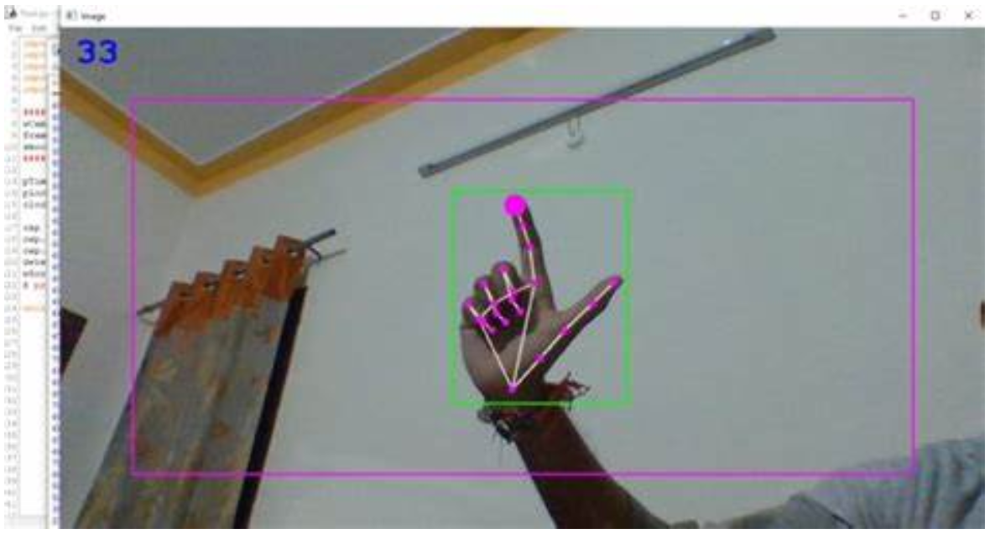
Project Description:
Problem statement:
Virtual mice today are traditionally done using computer vision and a camera (as seen on the right).
But these systems are processing and power intensive.
Solution proposal:
Create a virtual mouse using a Texas Instruments (TI) mmWave Radar and a ML model to make a less power and processing intensive virtual mouse.

Slide 3
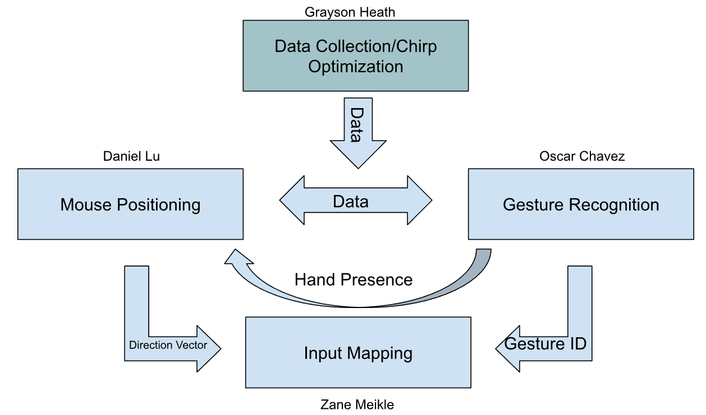
System Overview

Slide 4
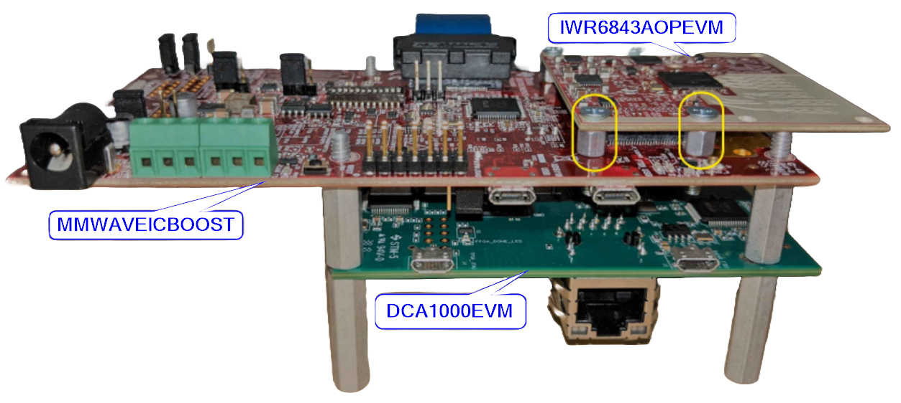
Chirp Optimization Subsystem
Use TI SDK’s to communicate with the three configured circuit boards
Establish an optimal chirp configuration for capturing gestures (mmWave and 6843)
Continuously output real-time usable data (DCA1000)

Slide 5
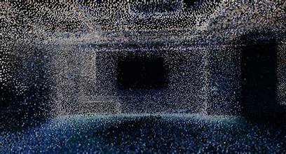
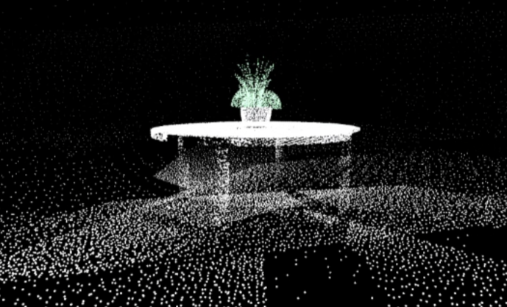
Gesture Recognition Subsystem
Point-Cloud data will be fed to a Machine Learning program to recognize hand gestures.
The point-clouds will be treated as video frames to create parallelism between the computer vision and radar approaches.
If a gesture is recognized by the program, a Gesture ID will be produced in the output.

Slide 6
Mouse Positioning Subsystem
Based on Gesture Recognition, a dot group simplified from point-cloud will represent the position of the Gesture.
The position, direction, velocity, and acceleration will be recorded to the positioning database.
The positioning data will be converted to mouse positioning on the computer.

Slide 7
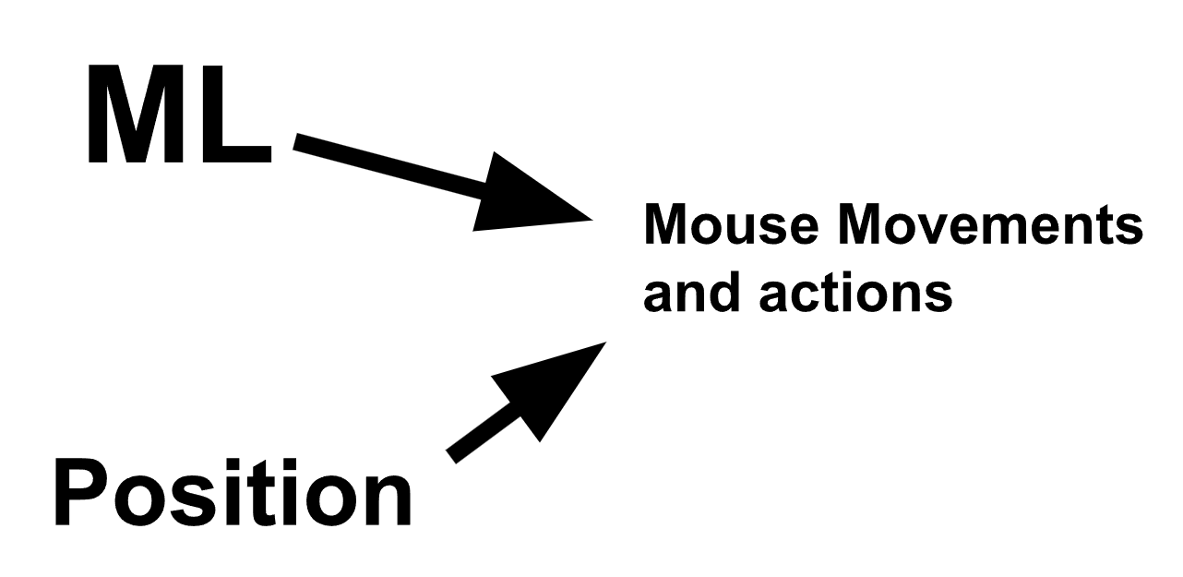
Input Mapping Subsystem
Input Mapping:
Take direction vector from mouse positioning subsystem and convert that to mouse movements
Take the gestures recognized by the Gesture Recognition Subsection and converts that into a mouse action such as right click and left click,.

Slide 8
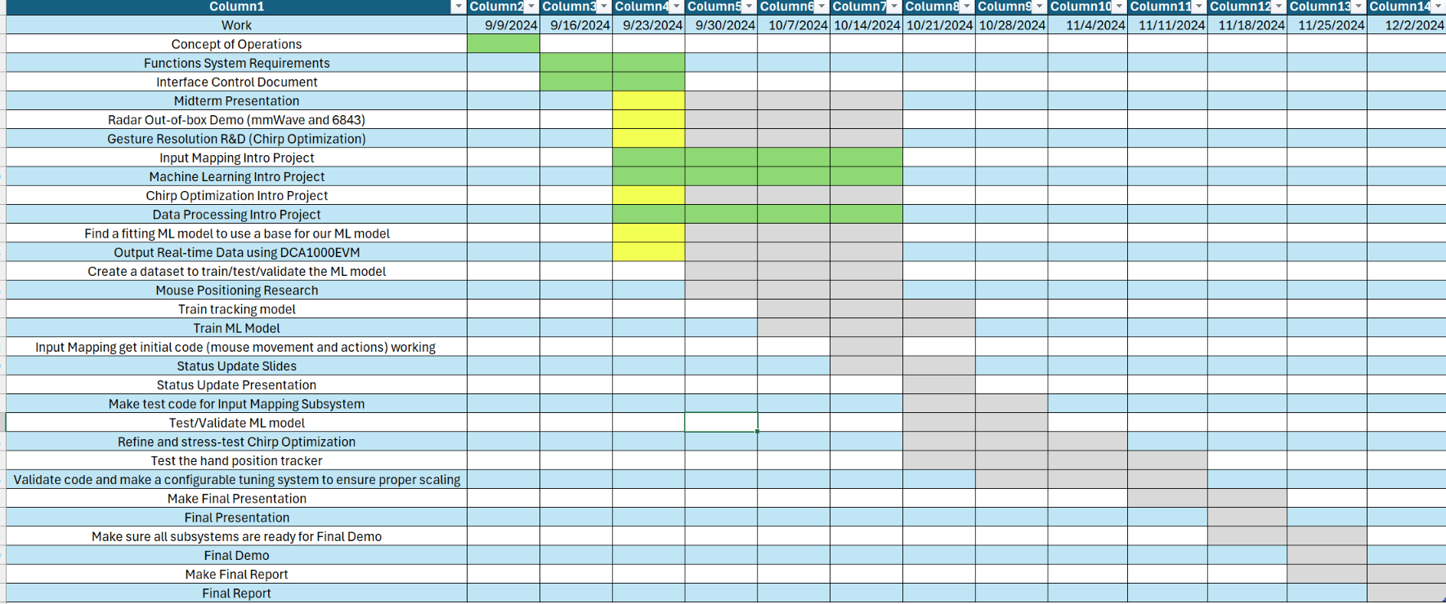
Execution Plan Gantt Chart

Slide 9
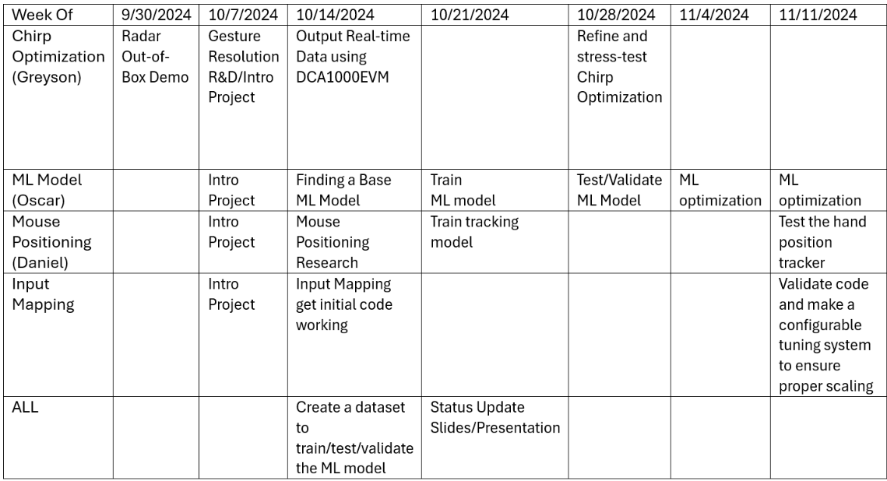
Execution Plan

Slide 10
Validation plan
Task | Specification | Result | Owner
Mouse Movement | Mouse can be moved to all corners of the screen by the program. |  | Zane
Mouse Actions | The program must be able to right click and left click. |  | Zane
Hand Plots | The shape of the gesture should be represented correctly by the plots. |  | Daniel
Hands Positions | The position of the hand must be correct according to the axis of radar |  | Daniel
Hand Recognition | ML model can recognize the dominant hand. |  | Oscar
Gesture Recognition | ML model can correctly identify and categorize hand gestures at least 90% of the time. |  | Oscar
Functional Radar System | The DCA1000EVM, IWR6843AOPEVM, and MMWAVEICBOOST all properly communicate, capture, and transmit gestures. |  | Greyson

